Slide 1
Urbanization and Environment
Urbanization is defined as the movement of people from communities concerned mainly with primary activities to other communities generally, whose activities are primarily centred in government, trade and manufacturing.

Slide 3
Causes of urbanisation
Migration of people from rural to urban
Amenities like housing, health, transport, energy, education etc.
Rural areas lacking in economic development, indebtedness of farmers, lack of basic services like health, education, transport etc.
Government’s allotment of funds for economic development are more to urban areas than rural areas.
People in rural areas have more attraction to white and blue collar jobs and attraction to urban ways of life.

Slide 7
Migration
It is a form of geographical mobility or spatial mobility between one geographical unit and another, generally involving a change in residences from the place of origin or place of departure to the place of destination or arrival.
CAUSES:
Push factors= Reason for emigrating (leaving a place) because of a difficulty (such as food shortage, war, flood, drought etc.)
Economic =Unemployment, Low wages.
Non economic= War, Political, Religious or social
Pull factors= Reason for immigrating (moving into a place) because of something desirable (better climate, better food supply etc)
Economic = Recruitment, Transfer of job
Non economic= Marriage, One’s desire to live abroad

Slide 8
Types of migration
Internal
External
Emigration
Immigration
Population transfer
Impelled migration
Step migration
Chain migration
Return migration
Seasonal migration

Slide 10
Problems of urbanisation and migration
Stress on Urban resources water supply
Domestic water consumption
Power supply
Waste disposal
Problems of medical waste
Transport
Haphazard growth of suburbs and fringe
Health services
Vehicular emission
Change of landuse
Housing
Shantytowns
Degradation of air and water
Impact on biodiversity

Slide 11
Urban heat island
Areas in and around cities are generally warmer than comparable rural areas.
Urban development reduces vegetative cover and adds heat absorbing surfaces such as rooftops, buildings and paving.
Heat is also added from other sources in cities such as fuel combustion and air conditioning units. The result is ‘Urban heat island’.
Increased air pollution and greenhouse gas emissions.
Affects human health.
Warmer storm water runoff affecting water quality.
Heat island impacts can be reduced by increased solar reflectivity of urban surfaces by installing cool or green roofs or more reflective paving materials.

Slide 12
Smart cities and sustainable cities
According to smart cities council, A smart city is one that has digital technology rooted across all city functions.
According to Indian government, it offers sustainability in terms of economic activities and employment opportunities to its residents.
It denotes an urban area that provides world class, sustainable infrastructure, including uninterrupted clean water and water supply, roads, high speed internet, automated waste disposal sustainable housing and digitized public services.
Raising funds is the key challenge.

Slide 13
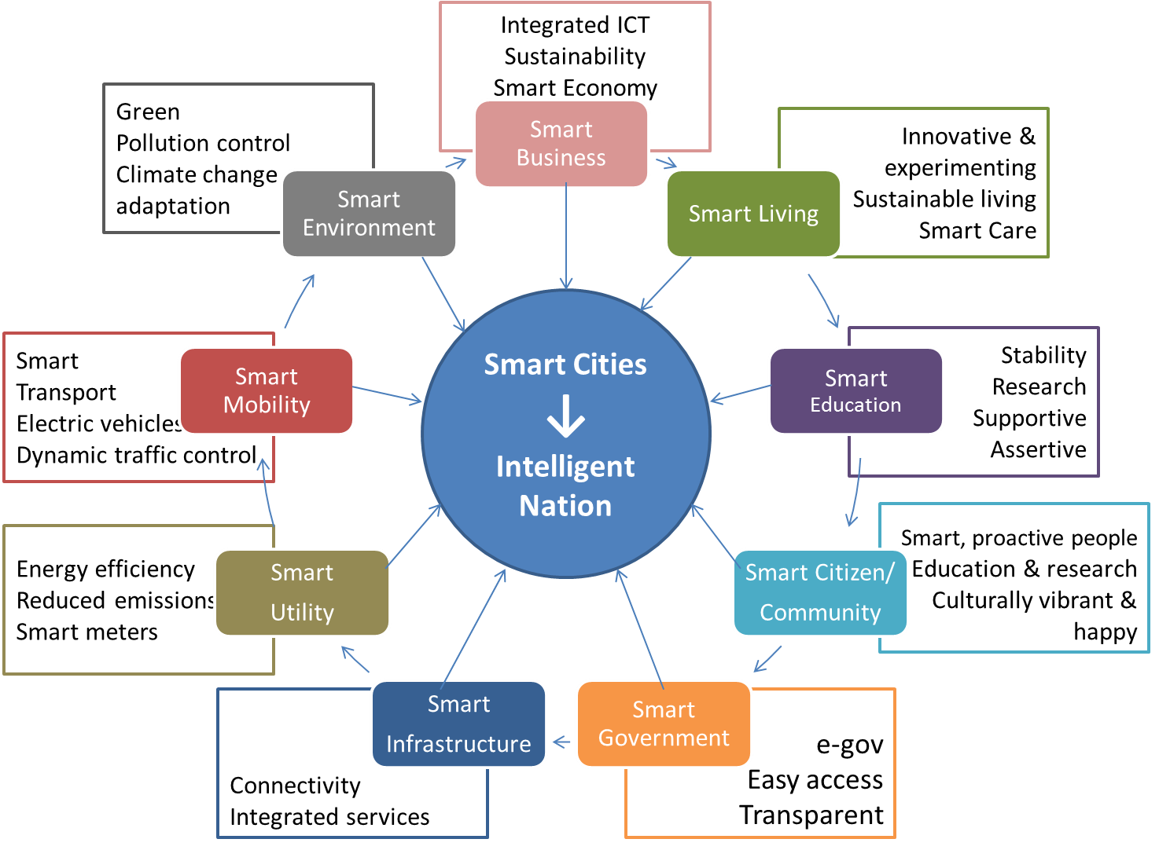
Smart CIties

Slide 20
Sustainable cities

